Slide 1

JOB RECOMMENDER
Notes:
Good morning everyone! Today I would like to present my final prject about JOB recommender!
The idea of my project is to help not only mysefl but also other people in the bootcamp and job seekers to find a job in Data field.
At the end of my talk, I will show you an app to recommend jobs based on skills in the CV.

Slide 2
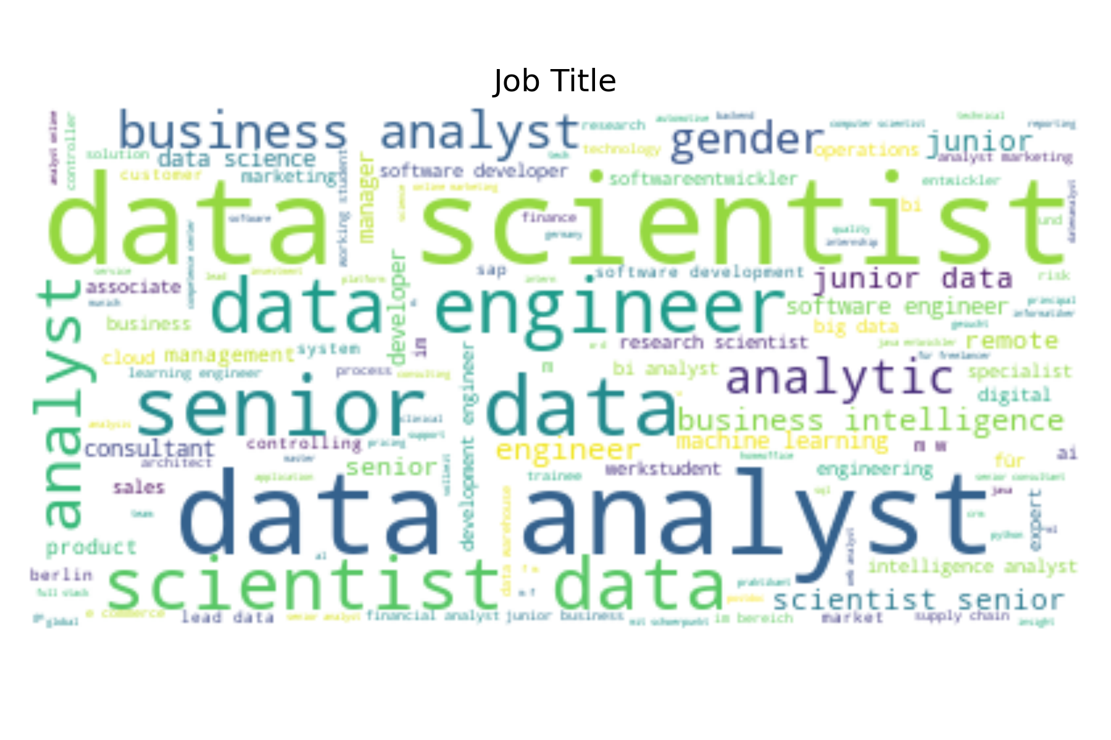



Data Aquisition
Keyword : Data scientist, Data Analyst
Place : Germany
Notes:
In order to get the app, first of all I had to collect some data.
I chose three popular platflorms for job search: Indeed, Glassdoor and Linkedin.
The job market is Germany and keywords I used are Data scientist and Data Analyst.
Now, let come to some statistics and insight about German Market.

Slide 3
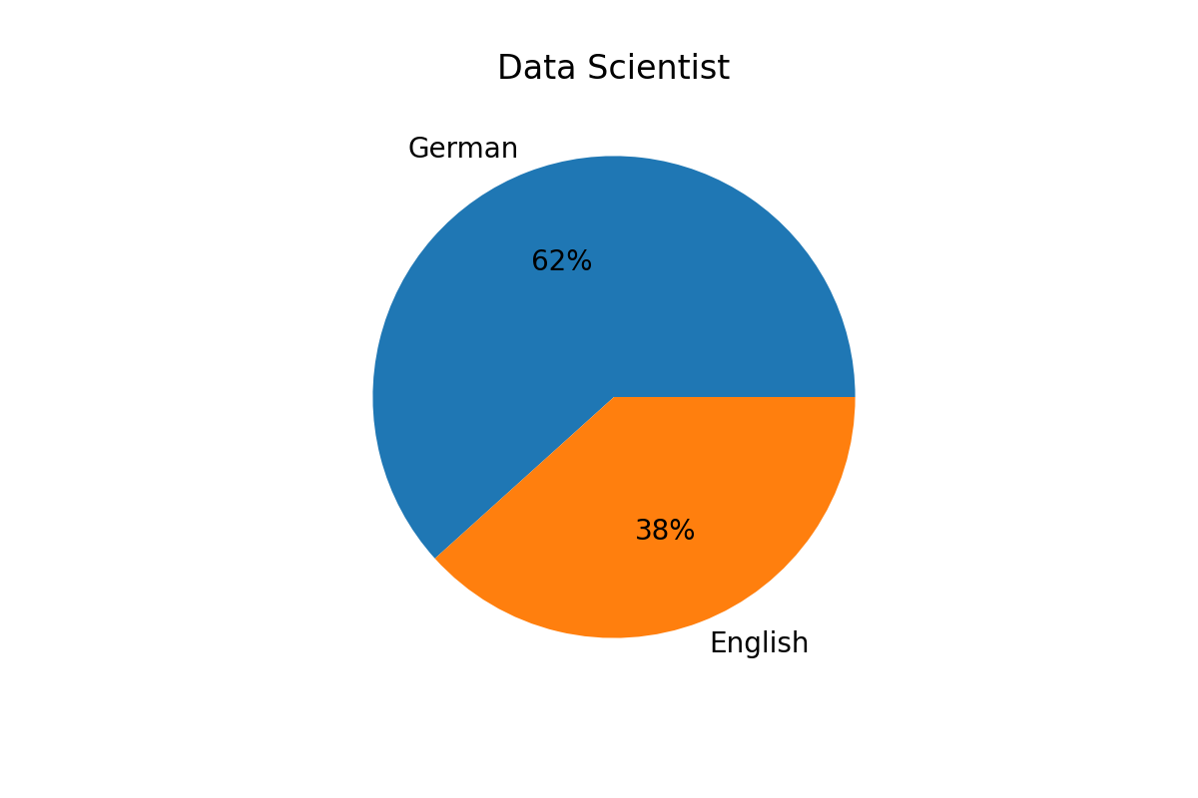
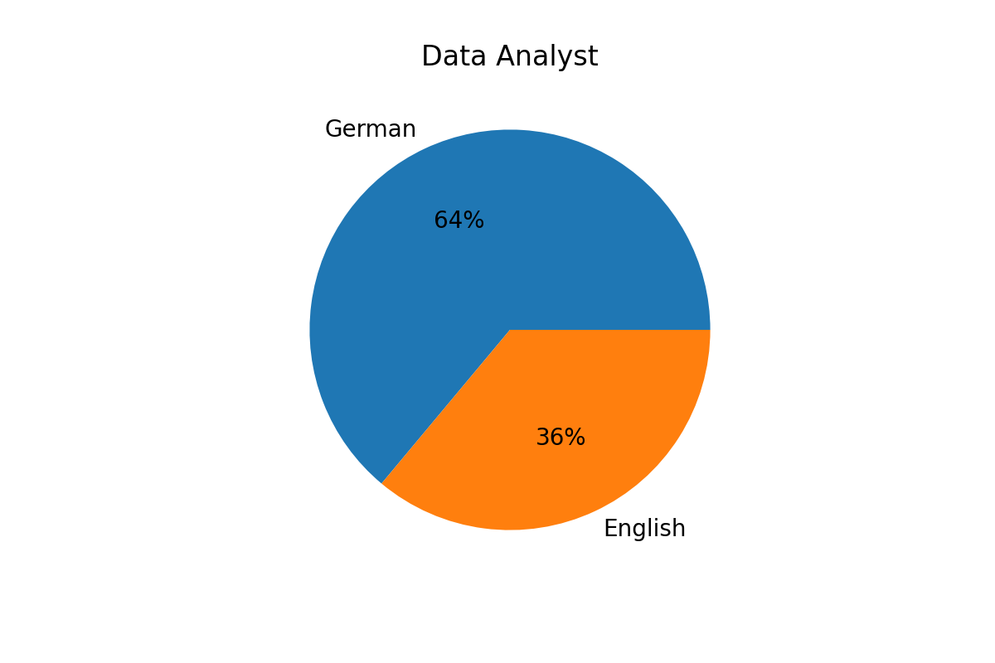
Language
Notes:
Frist about languages.
As you can see the number of job in German is dominant the number of job in English.
What does that mean? You should somehow learn German to increase the chance to get a job in Data field.

Slide 4
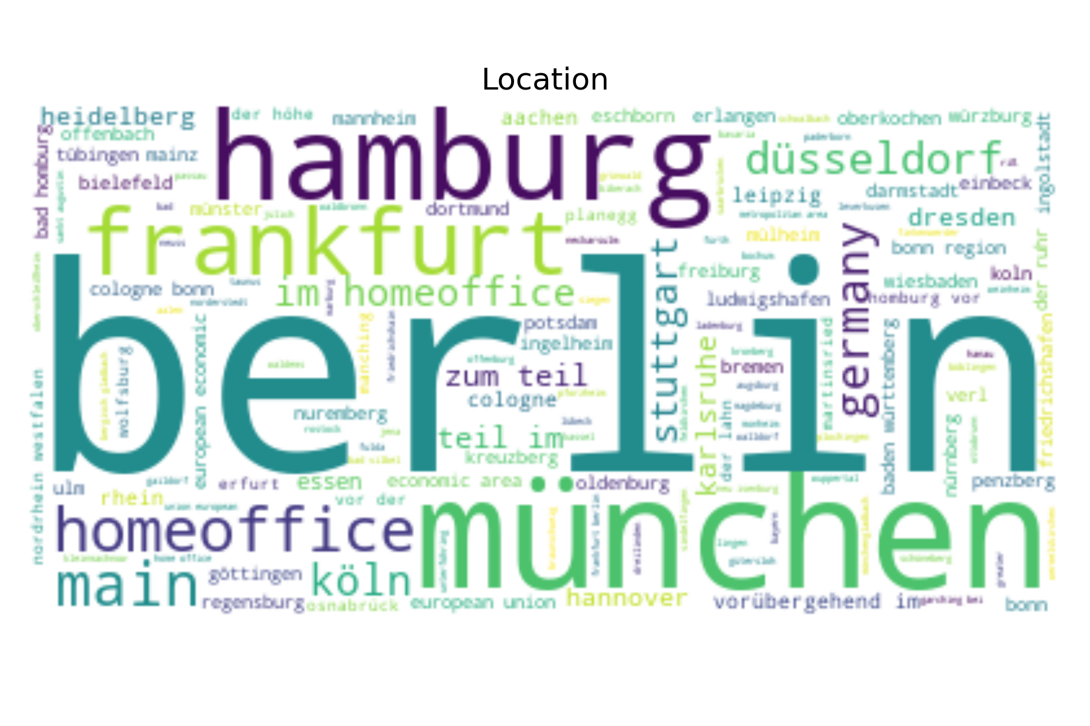
Location
1. Berlin
2. Munich
3. Hamburg
4. Homeoffice
5. Frankfurt, Stuttgart, Düsseldorf
Notes:
Next, come to location. There are three big cities for Data jobs: Berlin, Munich and Hamburg.
On the other hand, there are a lot of companies offering homeoffice to employees

Slide 5






Company
Notes:
Here are top companies. On the left hand side are tech companies. And on the right hand side are the consulting companies.
They offer a lot of job in Data Scientist and Data Analyst.

Slide 6
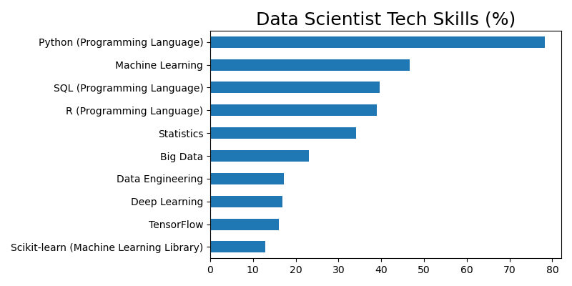
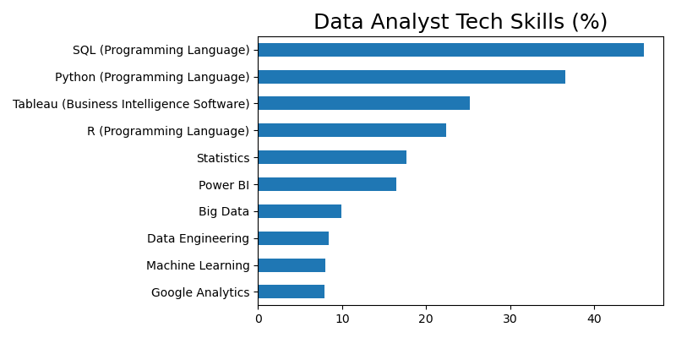
Tech skill
Notes:
Last but not least, let talk about some top technical skills for data scientist and data analyst.
Almost eighty percents job posts in Data scientist require Python as the main programing language. On the other hand, SQL is the top 1 skill for data analyst.
If you want to go for data scientist, you should understand machine learning techniques. In constrast, machine learning is not so important for data analyst, but visualization tool likes tableau or power BI is more important .
Now, let come to the app.

